Slide 1
Cell counter app
Saving time for humans

Slide 2
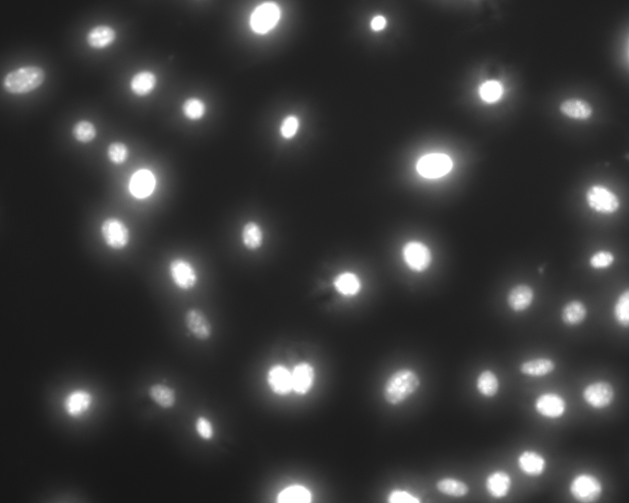
Motivation
Problem: Manual cell counting takes time
Solution: Automate it.

Slide 3
Planned features
Zoom in to see segmentations
Select/Deselect segmentations
Cell areas histogram
Other analysis ?
Fractal dimension ?

Slide 4
Challenges to be solved
Confocal images segmentation
Light microscopy images segmentation
Clumped cells
Dispersed cells

